Slide 1
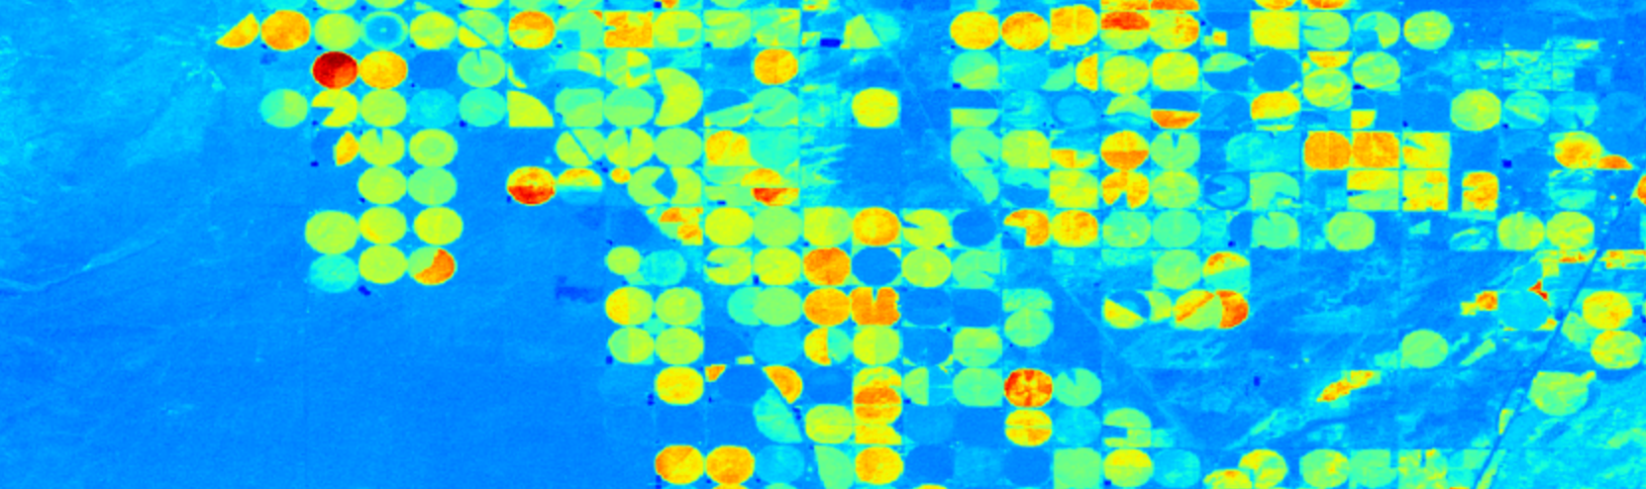
Capstone: Part 2
Byron Allen
Data Science Student at General Assembly
28 October 2016

Slide 2
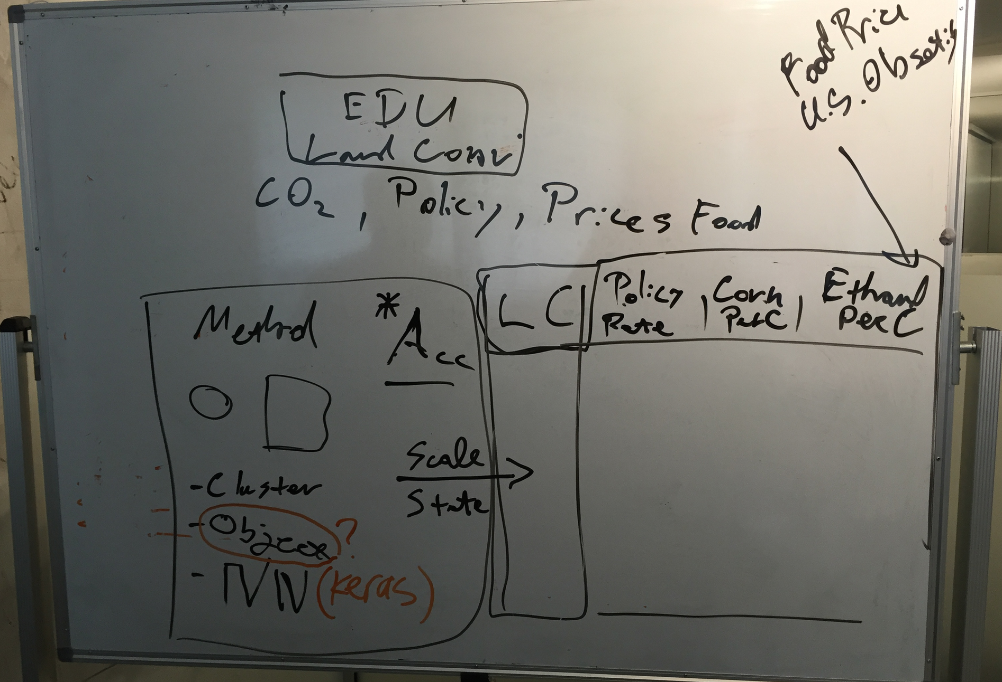
Master Plan

Slide 3

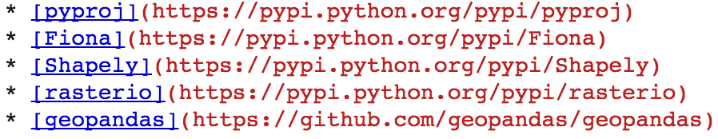
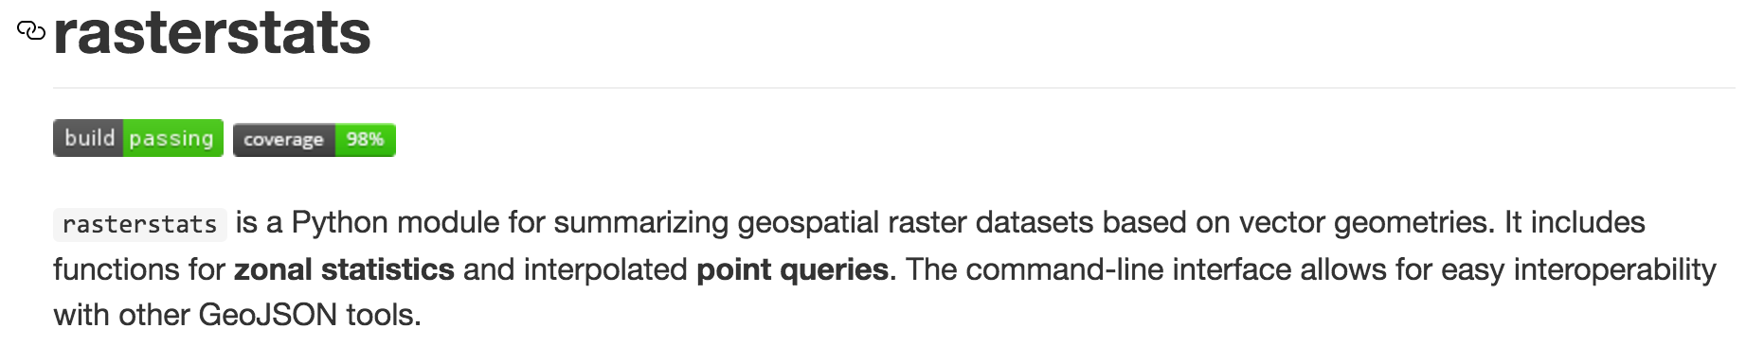

Resources
Data Acquisition
Python Resources

Slide 4
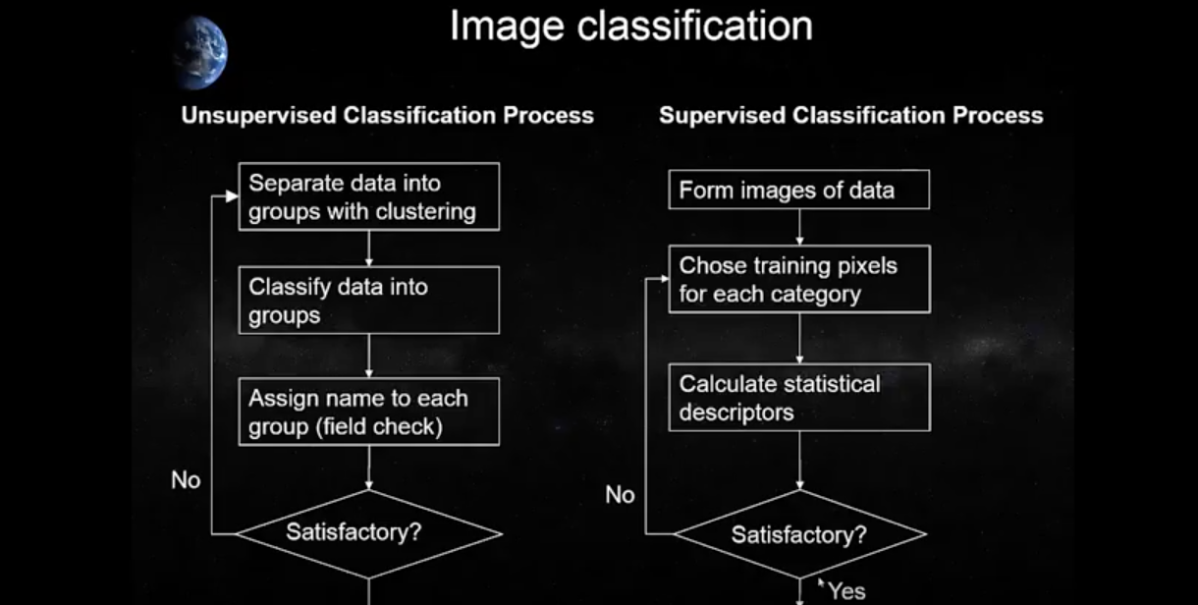
Supervised, Unsupervised

Slide 5
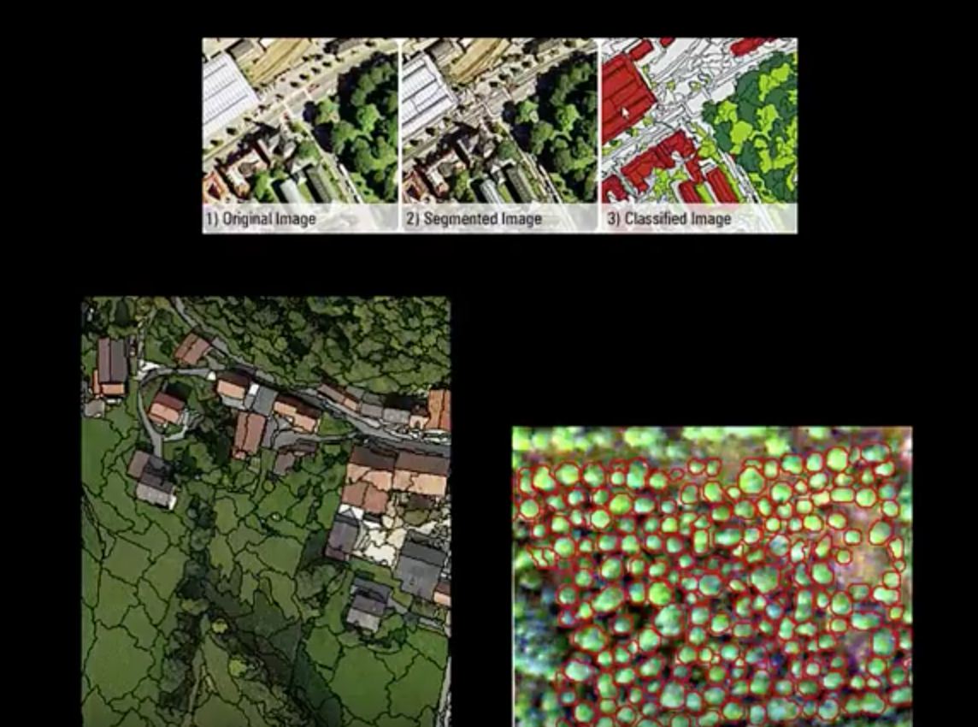
Segmentation & Object-based Image Analysis (OBIA)

